Slide 1


Slide 2
Table of Contents
Introduction to Spark
Hadoop Vs Spark
Spark Setup

Slide 3
What is Spark?
Apache Spark is an open-source cluster computing framework. Its primary purpose is to handle the real-time generated data.
Spark was built on the top of the Hadoop MapReduce.
It was optimized to run in memory whereas alternative approaches like Hadoop's MapReduce writes data to and from computer hard drives.
So, Spark process the data much quicker than other alternatives.

Slide 4
History of Apache Spark
The Spark was initiated by Matei Zaharia at UC Berkeley's AMPLab in 2009.
It was open sourced in 2010 under a BSD license.
In 2013, the project was acquired by Apache Software Foundation. In 2014, the Spark emerged as a Top-Level Apache Project.

Slide 5
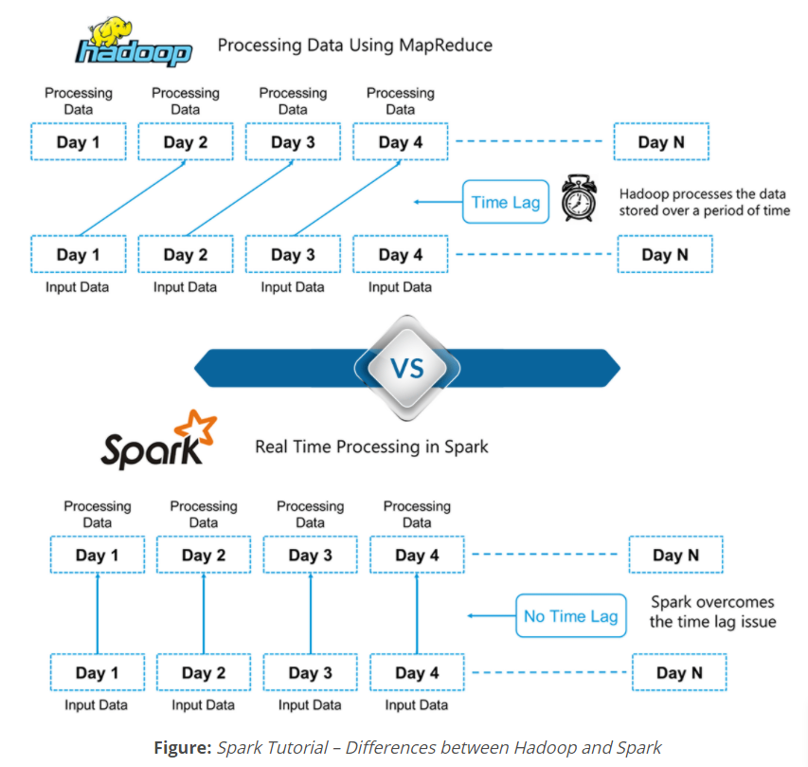

Slide 6
Features of Apache Spark
Fast - It provides high performance for both batch and streaming data, using a state-of-the-art DAG scheduler, a query optimizer, and a physical execution engine.
Easy to Use - It facilitates to write the application in Java, Scala, Python, R, and SQL. It also provides more than 80 high-level operators.
Generality - It provides a collection of libraries including SQL and DataFrames, MLlib for machine learning, GraphX, and Spark Streaming.
Lightweight - It is a light unified analytics engine which is used for large scale data processing.
Runs Everywhere - It can easily run on Hadoop, Apache Mesos, Kubernetes, standalone, or in the cloud.

Slide 7
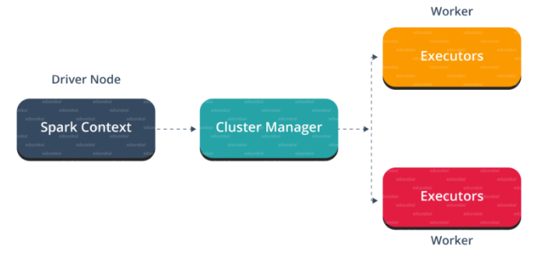


Slide 8
Uses of Spark
Data integration: The data generated by systems are not consistent enough to combine for analysis. To fetch consistent data from systems we can use processes like Extract, transform, and load (ETL). Spark is used to reduce the cost and time required for this ETL process.
Stream processing: It is always difficult to handle the real-time generated data such as log files. Spark is capable enough to operate streams of data and refuses potentially fraudulent operations.
Machine learning: Machine learning approaches become more feasible and increasingly accurate due to enhancement in the volume of data. As spark is capable of storing data in memory and can run repeated queries quickly, it makes it easy to work on machine learning algorithms.
Interactive analytics: Spark is able to generate the respond rapidly. So, instead of running pre-defined queries, we can handle the data interactively.

Slide 9
Key Differences Between Hadoop and Spark
The following sections outline the main differences and similarities between the two frameworks. We will take a look at Hadoop vs. Spark from multiple angles.
Some of these are cost, performance, security, and ease of use.
The table below provides an overview of the conclusions made in the following sections.

Slide 10
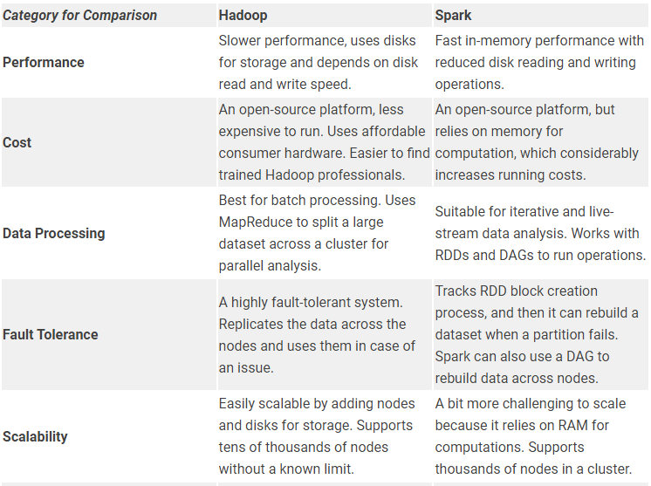
Hadoop and Spark Comparison

Slide 11
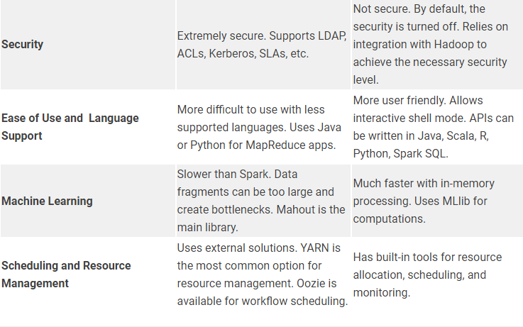

Slide 12
Use Cases of Hadoop versus Spark
Looking at Hadoop versus Spark in the sections listed above, we can extract a few use cases for each framework.
Hadoop use cases include:
Processing large datasets in environments where data size exceeds available memory.
Building data analysis infrastructure with a limited budget.
Completing jobs where immediate results are not required, and time is not a limiting factor.
Batch processing with tasks exploiting disk read and write operations.
Historical and archive data analysis.

Slide 13
With Spark, we can separate the following use cases where it outperforms Hadoop:
The analysis of real-time stream data.
When time is of the essence, Spark delivers quick results with in-memory computations.
Dealing with the chains of parallel operations using iterative algorithms.
Graph-parallel processing to model the data.
All machine learning applications.

Slide 14
Install Apache Spark on Windows
Installing Apache Spark on Windows 10 may seem complicated to novice users, but this simple tutorial will have you up and running. If you already have Java 8 and Python 3 installed, you can skip the first two steps.
Step 1: Install Java 8
Apache Spark requires Java 8. You can check to see if Java is installed using the command prompt.
Open the command line by clicking ”Start > type cmd > click Command Prompt”.
Type the following command in the command prompt:
java -version

Slide 15
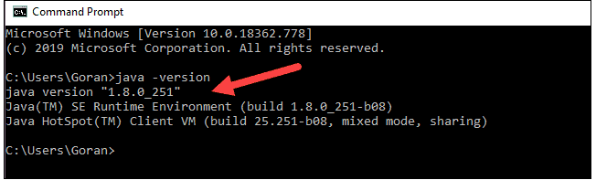
If Java is installed, it will respond with the following output:
Your version may be different. The second digit is the Java version – in this case, Java 8.
If you don’t have Java installed:

Slide 16
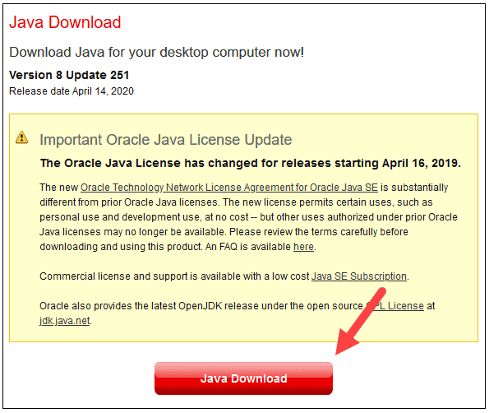
1. Open a browser window, and navigate to https://java.com/en/download/.

Slide 17
2. Click the Java Download button and save the file to a location of your choice.
3. Once the download finishes double-click the file to install Java.
Step 2: Install Python
1. To install the Python package manager, navigate to https://www.python.org/ in your web browser.
2. Mouse over the Download menu option and click Python 3.8.3. 3.8.3 is the latest version at the time of writing the article.
3. Once the download finishes, run the file.

Slide 18
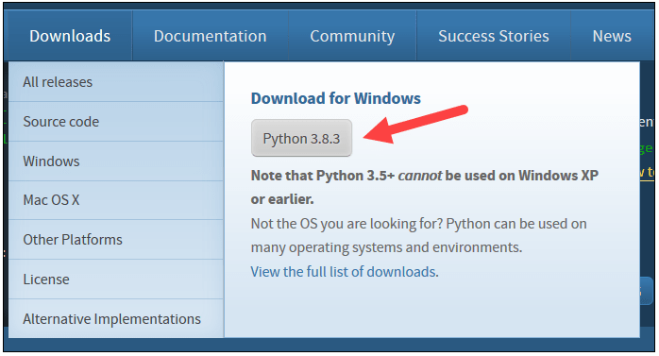
4. Near the bottom of the first setup dialog box, check off Add Python 3.8 to PATH. Leave the other box checked.

Slide 19
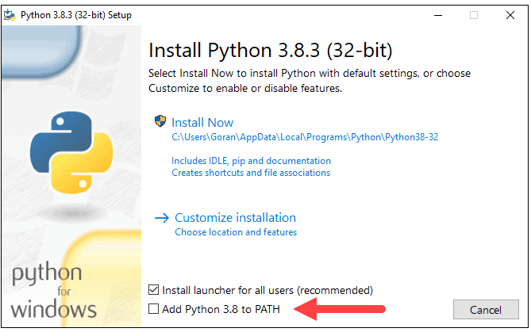
5. Next, click Customize installation.

Slide 20
6. You can leave all boxes checked at this step, or you can uncheck the options you do not want.
7. Click Next.
8. Select the box Install for all users and leave other boxes as they are.
9. Under Customize install location, click Browse and navigate to the C drive. Add a new folder and name it Python.
10. Select that folder and click OK.

Slide 21
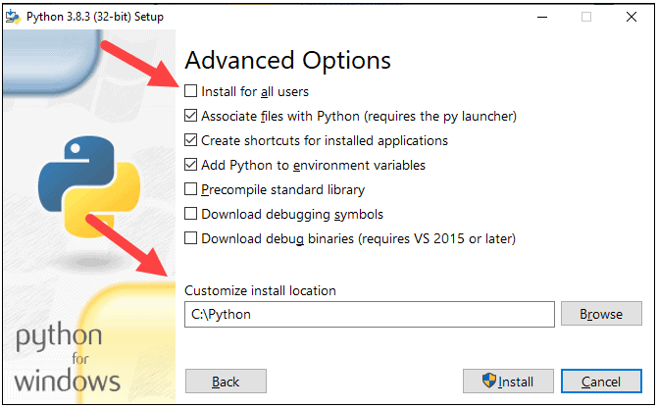

Slide 22
11. Click Install, and let the installation complete.
12. When the installation completes, click the Disable path length limit option at the bottom and then click Close.
13. If you have a command prompt open, restart it. Verify the installation by checking the version of Python:
python –version
The output should print Python 3.8.3.
Step 3: Download Apache Spark
1. Open a browser and navigate to https://spark.apache.org/downloads.html.
2. Under the Download Apache Spark heading, there are two drop-down menus. Use the current non-preview version.
In our case, in Choose a Spark release drop-down menu select 2.4.5 (Feb 05 2020).
In the second drop-down Choose a package type, leave the selection Pre-built for Apache Hadoop 2.7.

Slide 23
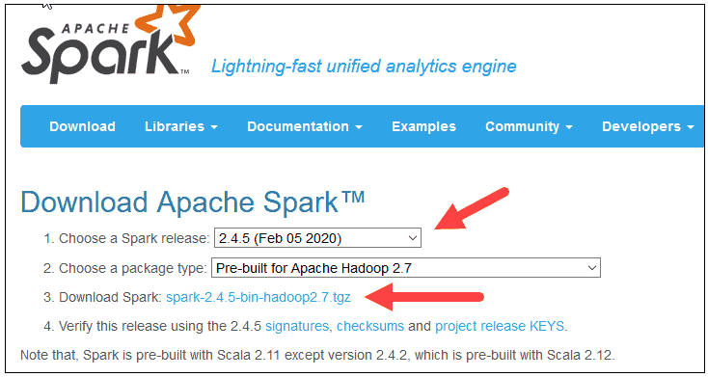
3. Click the spark-2.4.5-bin-hadoop2.7.tgz link.

Slide 24
4. A page with a list of mirrors loads where you can see different servers to download from. Pick any from the list and save the file to your Downloads folder.
Step 4: Verify Spark Software File
Verify the integrity of your download by checking the checksum of the file. This ensures you are working with unaltered, uncorrupted software.
Navigate back to the Spark Download page and open the Checksum link, preferably in a new tab.
3. Next, open a command line and enter the following command:
certutil -hashfile c:\users\username\Downloads\spark-2.4.5-bin-hadoop2.7.tgz SHA512

Slide 25
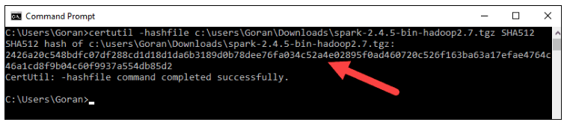
4. Change the username to your username. The system displays a long alphanumeric code, along with the message Certutil: -hashfile completed successfully.
5. Compare the code to the one you opened in a new browser tab. If they match, your download file is uncorrupted.

Slide 26
Step 5: Install Apache Spark
Installing Apache Spark involves extracting the downloaded file to the desired location.
1. Create a new folder named Spark in the root of your C: drive. From a command line, enter the following:
cd \
mkdir Spark
2. In Explorer, locate the Spark file you downloaded.
3. Right-click the file and extract it to C:\Spark using the tool you have on your system (e.g., 7-Zip).
4. Now, your C:\Spark folder has a new folder spark-2.4.5-bin-hadoop2.7 with the necessary files inside.

Slide 27
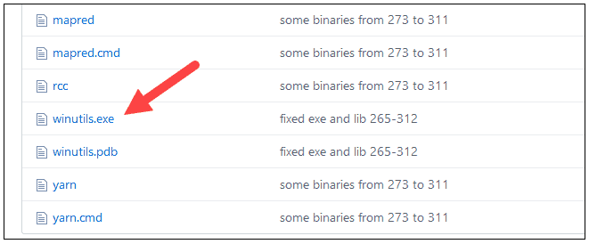
Step 6: Add winutils.exe File
Download the winutils.exe file for the underlying Hadoop version for the Spark installation you downloaded.
1. Navigate to this URL https://github.com/cdarlint/winutils and inside the bin folder, locate winutils.exe, and click it.

Slide 28
2. Find the Download button on the right side to download the file.
3. Now, create new folders Hadoop and bin on C: using Windows Explorer or the Command Prompt.
4. Copy the winutils.exe file from the Downloads folder to C:\hadoop\bin.
Step 7: Configure Environment Variables
Configuring environment variables in Windows adds the Spark and Hadoop locations to your system PATH. It allows you to run the Spark shell directly from a command prompt window.
1. Click Start and type environment.
2. Select the result labeled Edit the system environment variables.
3. A System Properties dialog box appears. In the lower-right corner, click Environment Variables and then click New in the next window.

Slide 29
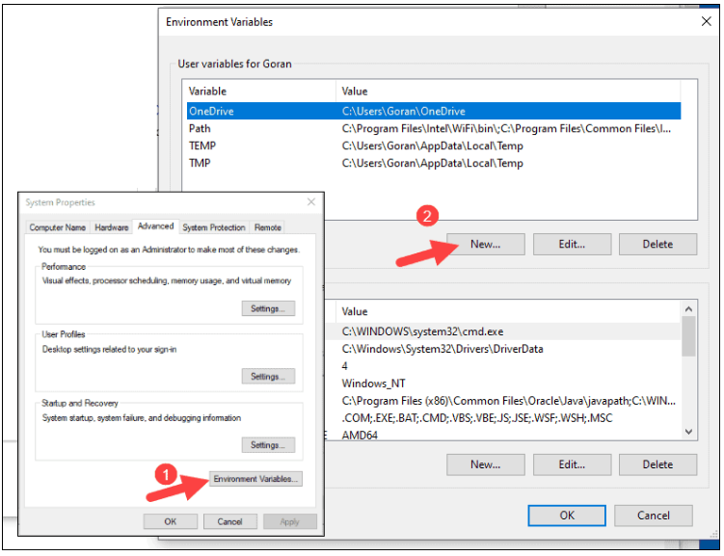

Slide 30
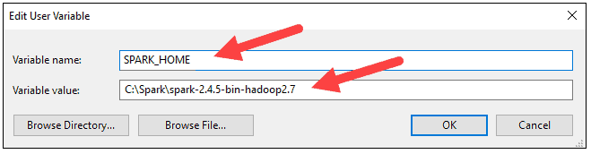
4. For Variable Name type SPARK_HOME.
5. For Variable Value type C:\Spark\spark-2.4.5-bin-hadoop2.7 and click OK. If you changed the folder path, use that one instead.
6. In the top box, click the Path entry, then click Edit. Be careful with editing the system path. Avoid deleting any entries already on the list.

Slide 31
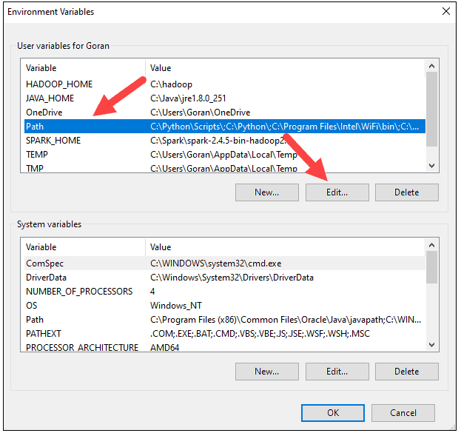

Slide 32
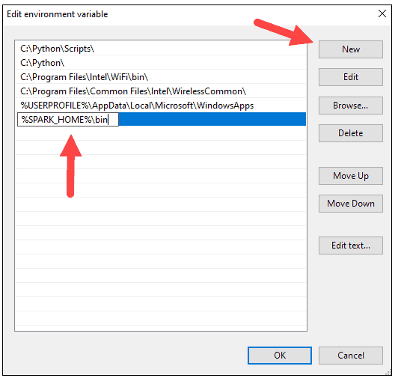
7. You should see a box with entries on the left. On the right, click New.
8. The system highlights a new line. Enter the path to the Spark folder C:\SPSpark\spark-2.4.5-bin-hadoop2.7\bin. We recommend using %ARK_HOME%\bin to avoid possible issues with the path.

Slide 33
9. Repeat this process for Hadoop and Java.
For Hadoop, the variable name is HADOOP_HOME and for the value use the path of the folder you created earlier: C:\hadoop. Add C:\hadoop\bin to the Path variable field, but we recommend using %HADOOP_HOME%\bin.
For Java, the variable name is JAVA_HOME and for the value use the path to your Java JDK directory (in our case it’s C:\Program Files\Java\jdk1.8.0_251).
10. Click OK to close all open windows.

Slide 34
Step 8: Launch Spark
1. Open a new command-prompt window using the right-click and Run as administrator:
2. To start Spark, enter:
C:\Spark\spark-2.4.5-bin-hadoop2.7\bin\spark-shellI
f you set the environment path correctly, you can type spark-shell to launch Spark.
3. The system should display several lines indicating the status of the application. You may get a Java pop-up. Select Allow access to continue.
Finally, the Spark logo appears, and the prompt displays the Scala shell.

Slide 35
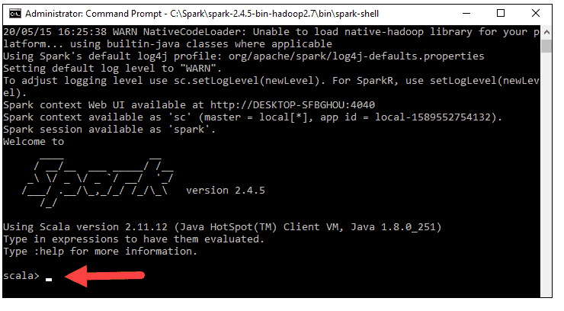

Slide 36
4. Open a web browser and navigate to http://localhost:4040/.
5. You can replace localhost with the name of your system.
6. You should see an Apache Spark shell Web UI. The example below shows the Executors page.
7. To exit Spark and close the Scala shell, press ctrl-d in the command-prompt window.
Note: If you installed Python, you can run Spark using Python with this command:
pyspark
8. Exit using quit().

Slide 37
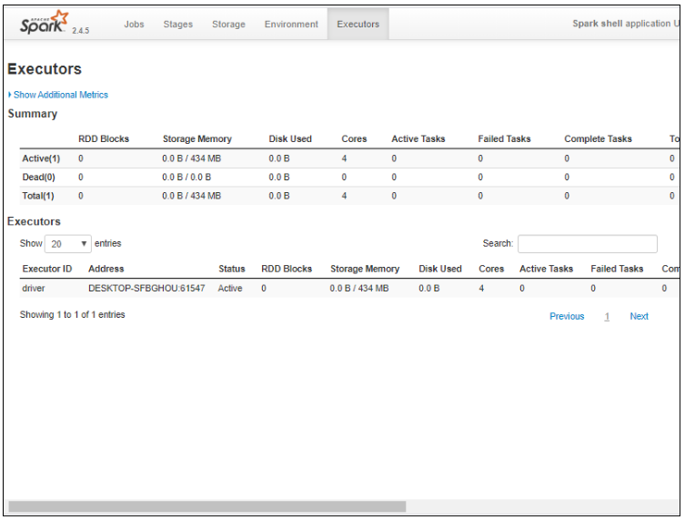

Slide 38
Test Spark
In this example, we will launch the Spark shell and use Scala to read the contents of a file. You can use an existing file, such as the README file in the Spark directory, or you can create your own. We created pnaptest with some text.
1. Open a command-prompt window and navigate to the folder with the file you want to use and launch the Spark shell.
2. First, state a variable to use in the Spark context with the name of the file. Remember to add the file extension if there is any.
val x =sc.textFile("pnaptest")
3. The output shows an RDD is created. Then, we can view the file contents by using this command to call an action:
x.take(11).foreach(println)

Slide 39
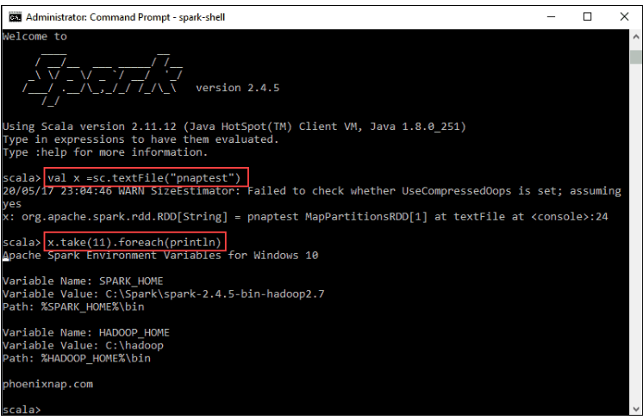

Slide 40
This command instructs Spark to print 11 lines from the file you specified. To perform an action on this file (value x), add another value y, and do a map transformation.
4. For example, you can print the characters in reverse with this command:
val y = x.map(_.reverse)
5. The system creates a child RDD in relation to the first one. Then, specify how many lines you want to print from the value y:
y.take(11).foreach(println)

Slide 41
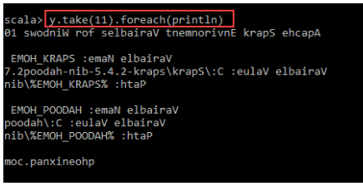
The output prints 11 lines of the pnaptest file in the reverse order.
When done, exit the shell using ctrl-d.

Slide 42
LET’S DO PRACTICE

